Slide 1



MENTAL HEALTH ANALYSIS
An overview
Anuja Alluri & Makaela Bennett

Slide 2

Project overview...............................
03
Dataset overview..............................
04
Analysis ................................................
06
TABLE OF CONTENTS
06
Data cleaning...................
07
Descriptive analysis.......
Machine learning............
15
Summary .............................................
18

Slide 3

PROJECT OVERVIEW
Mental health plays a key role in how people think, feel, and live their daily lives. It is influenced by several lifestyle and personal factors.
In this project, we aim to:
Identify key factors that affect mental health risk
Understand how these factors interact
Build a model that can predict risk levels early for timely support

Slide 4
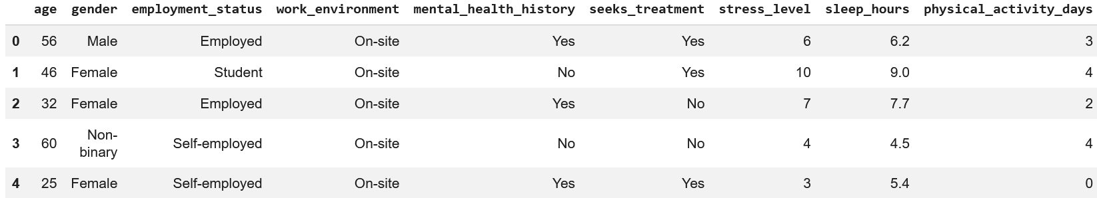
DATASET OVERVIEW
The mental health dataset is a well-known synthetic dataset in the field of data science and consists of survey-based measurements from 10,000 individuals, categorized into certain features.

Slide 5
DATASET OBSERVATIONS
Contains 10,000 diverse and anonymized records
Dataset includes features related to mental health and lifestyle
Includes key features like stress, sleep, depression, anxiety, and support levels
Data is suitable for classification and pattern detection tasks

Slide 6



Data cleaning
There are 13 columns of data:
8 Numerical columns
2 String columns
3 Categorical columns
Checked dataset for missing or null values
Verified data types for each feature
Encoded categorical/string variables into numerical format
Scaled numerical features using normalization/standardization

Slide 7

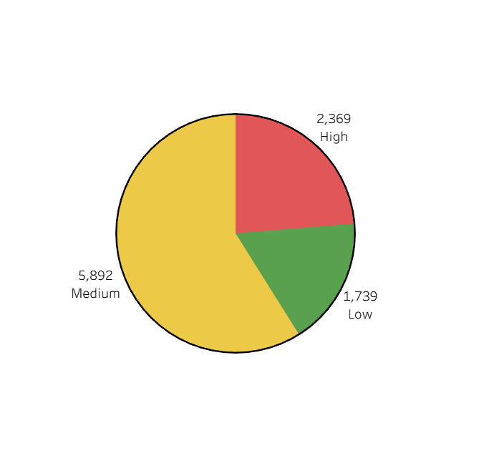
Risk Level Distribution
Most individuals are in the Medium Risk category
High and Low Risk groups are smaller but important for prediction
Distribution suggests slight imbalance in the dataset

Slide 8
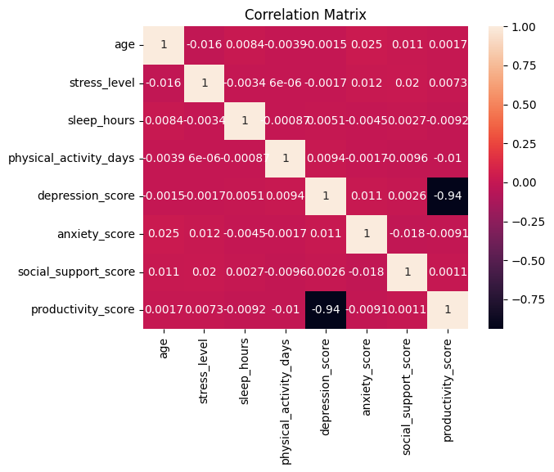
CORRELATION AMONG INPUT FEATURES
Correlation matrix shows how the independent variables (x features) relate to each other.
Highly correlated features might carry overlapping information and can influence model
Darker colors indicate strong correlations
The only features with strongly correlation: Productivity & Depression score

Slide 9
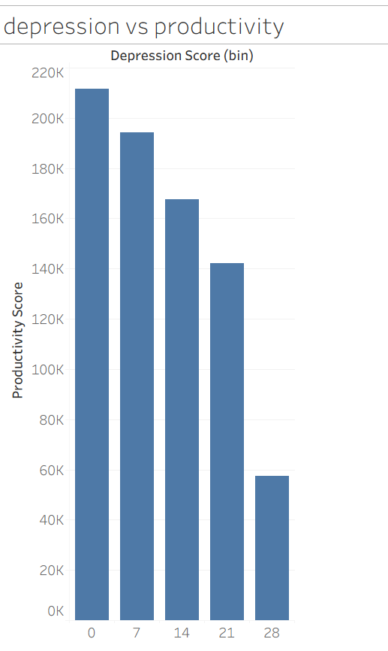
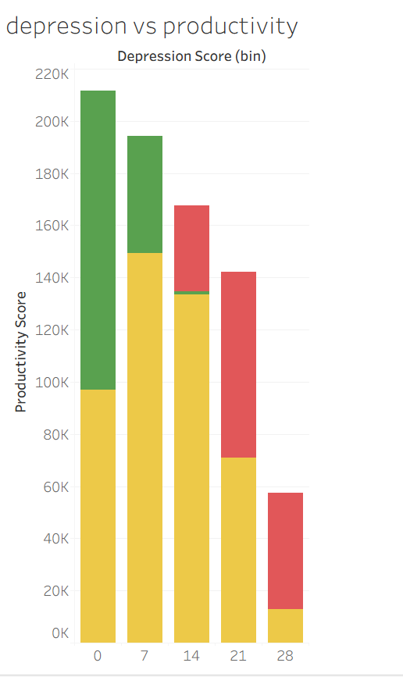
PRODUCTIVITY VS DEPRESSION SCORE
Correlation:
This Histogram shows how productivity score relates to depression score
They both have negative correlation
Clear downward trend
Shows how mental health symptoms can directly affect day to day performances
As the trend goes down → Risk is Higher
5

Slide 10
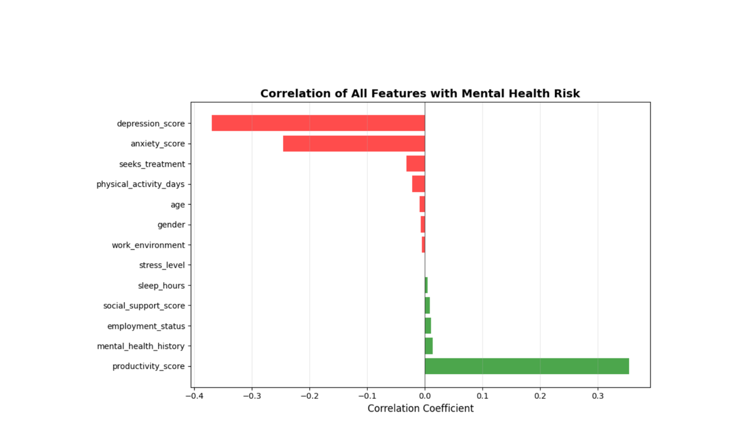
CORRELATION BETWEEN INPUT AND OUTPUT FEATURES
This map shows features that might affect the mental health risk high or low
Positive = Protective factors lowering the risk
Negative = Higher chance of Medium/High risk as low risk goes down

Slide 11
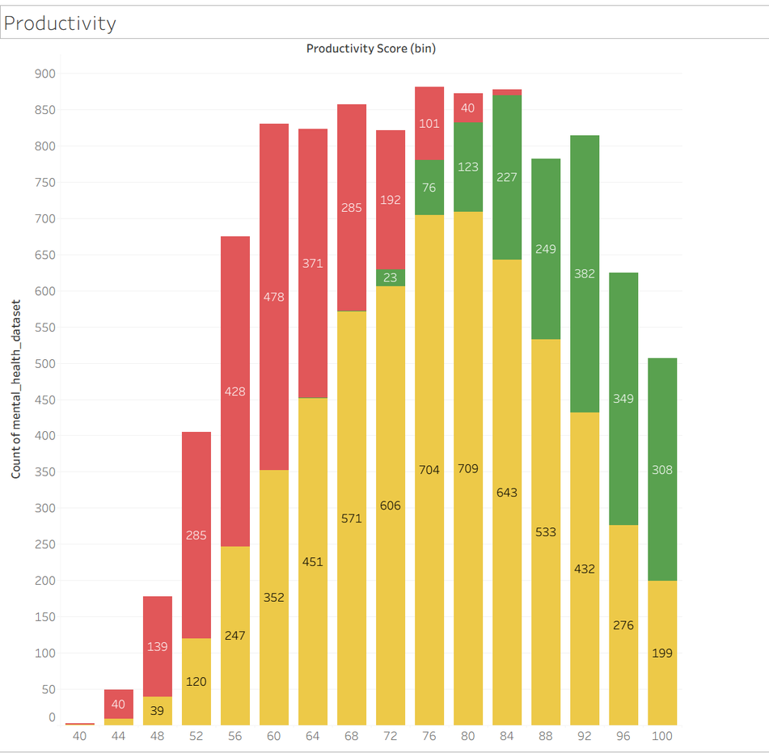
POSITIVE CORRELATION ANALYSIS
Features that slightly decrease the risk level:
Productivity score: 0.36
History: 0.01
Employment status: 0.01
Social support: 0.01
Sleep Hours : 0.01

Slide 12
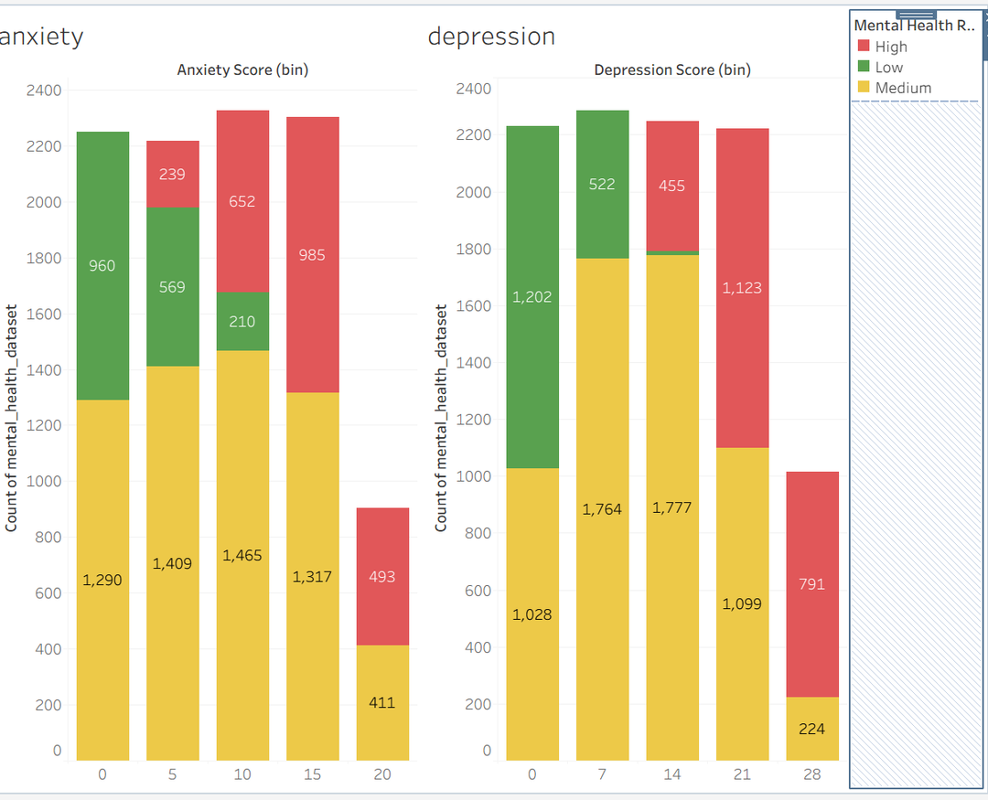
NEGATIVE CORRELATION ANALYSIS
Features that slightly increase the risk level:
Depression score: -0.37
Anxiety Score: -0.25
Seeks Treatment: -0.03
Physical activity: -0.02
Age: -0.01

Slide 13

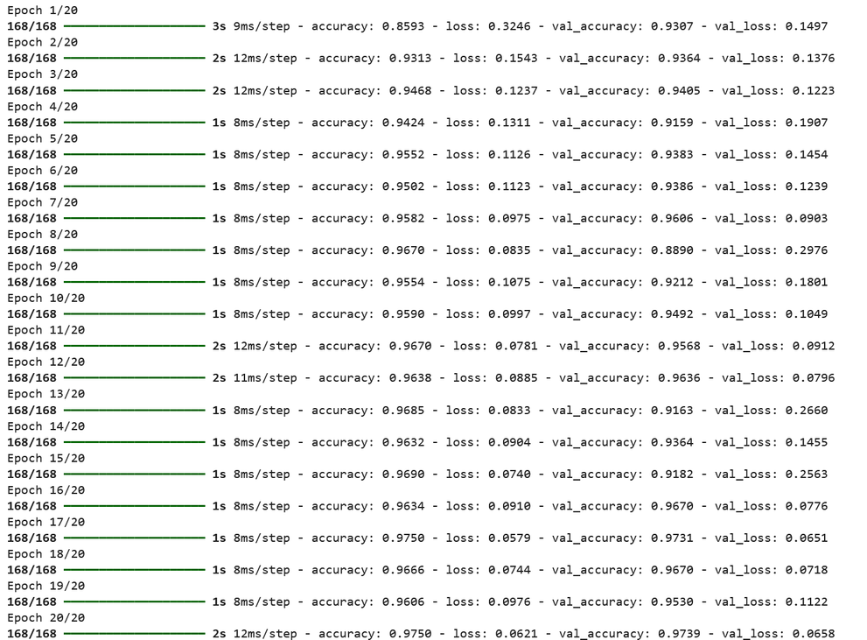
Training
Neural Network Model & Training
Built a Neural Network (ANN) model
Model consists of multiple dense layers to fully connect
Used ReLu activation for hidden layers
Used softmax for multi-class classification (Low/Medium/High)
Train Accuracy: 98.88%
Training Loss: 3.39%

Slide 14
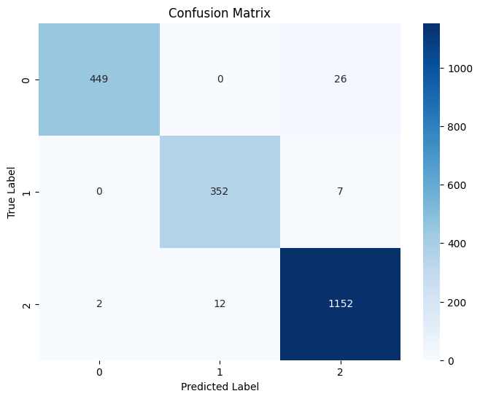
Model Performance & Evaluation
Testing
Test Accuracy: 97.7%
Test Loss: 6.2%
Model shows high precision and recall across all classes
Indicates very few false predictions and missed cases
F-1 scores shows how strong and balanced models performance.

Slide 15
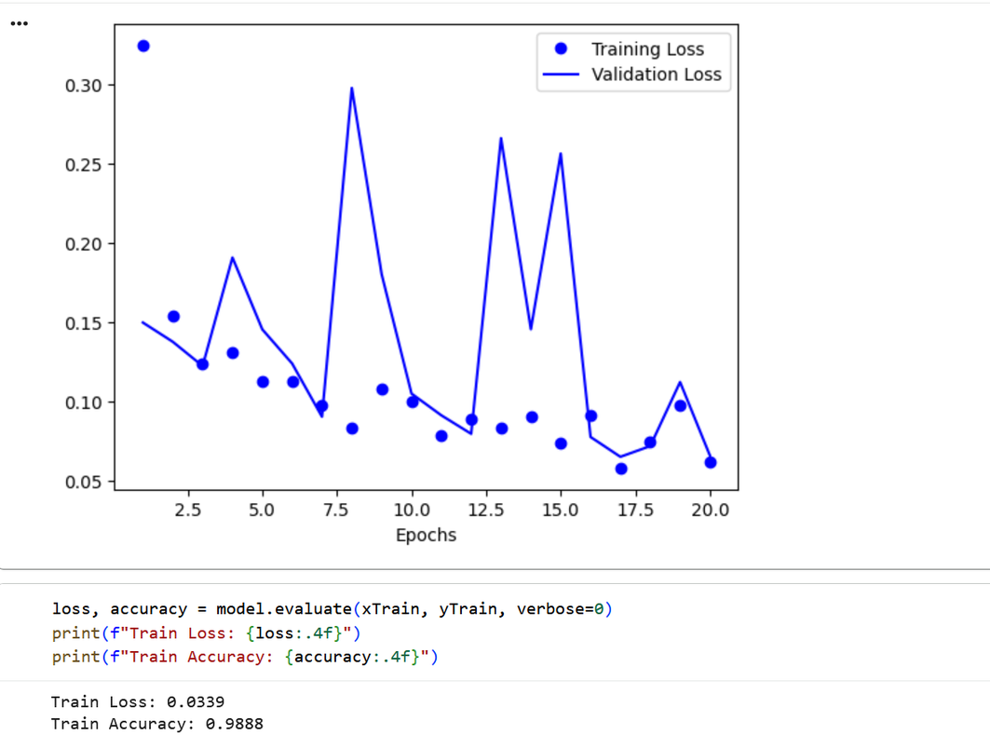
Training vs validation performance
Validation
Dataset split:- 80:20
Accuracy increases steadily during training
Loss decreases consistently over eopchs
Training and validation curves are closely aligned in the last epochs.
Model shows stable and reliable learning

Slide 16

SUMMARY
Analysis shows what factors impact mental‑health risk the most.
Depression, anxiety, and low sleep hours push risk up.
More productivity, sleep, and having support help lower risk.
Correlation analysis made it clear which features matter.
ANN model performed really well on both training and unseen test data.
Model can predict Low/Medium/High risk with high accuracy and stable performance

